Slide 1
jQuery 2.1.1
05-May-18 | Start
Appendix
Online

Slide 2
jQuery 2.1.1
Ch | Date
1 | ddmmmyy
2
3
4
5
6
7
8
Mastering jQuery 2.1.1 05 2015

Slide 3
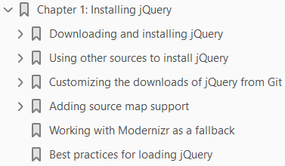
1
Installing jQuery

Slide 4
Intro
Local or CDN, I wonder…? Which version…? Do I support old IE…?
Installing jQuery is a thankless task that has to be done countless times by any developer—it is easy to imagine that person asking some of the questions that start this chapter.
It is easy to imagine why most people go with the option of using a Content Delivery Network (CDN) link, but there is more to installing jQuery than taking the easy route!
There are more options available, where we can be really specific about what we need to use—throughout this chapter, we will examine some of the options available to help develop your skills even further.
We'll cover a number of topics, which include:
Downloading and installing jQuery
Customizing jQuery downloads
Building from Git
Using other sources to install jQuery
Adding source map support
Working with Modernizr as a fallback
Intrigued? Let's get started.

Slide 5
Downloading and installing jQuery
As with all projects that require the use of jQuery, we must start somewhere—no doubt you've downloaded and installed jQuery a thousand times; let's just quickly recap to bring ourselves up to speed.
If we browse to http://www.jquery.com/download, we can download jQuery using one of the two methods:
downloading the compressed production version or
the uncompressed development version.
If we don't need to support old IE (IE6, 7, and 8), then we can choose the 2.x branch.
If, however, you still have some diehards who can't (or don't want to) upgrade, then the 1.x branch must be used instead.
To include jQuery, we just need to add this link to our page:
Here, X.X.X marks the version number of jQuery or the Migrate plugin that is being used in the page.
Conventional wisdom states that the jQuery plugin (and this includes the Migrate plugin too) should be added to the <head> tag, although there are valid arguments to add it as the last statement before the closing <body> tag; placing it here may help speed up loading times to your site.

Slide 6
Downloading and installing jQuery |
This argument is not set in stone; there may be instances where placing it in the <head> tag is necessary and this choice should be left to the developer's requirements.
My personal preference is to place it in the <head> tag as it provides a clean separation of the script (and the CSS) code from the main markup in the body of the page, particularly on lighter sites.
I have even seen some developers argue that there is little perceived difference if jQuery is added at the top, rather than at the bottom; some systems, such as WordPress, include jQuery in the <head> section too, so either will work.
The key here though is if you are perceiving slowness, then move your scripts to just before the <body> tag, which is considered a better practice.

Slide 7
Using jQuery in a development capacity
A useful point to note at this stage is that best practice recommends that CDN links should not be used within a development capacity; instead, the uncompressed files should be downloaded and referenced locally.
Once the site is complete and is ready to be uploaded, then CDN links can be used.

Slide 8
Adding the jQuery Migrate plugin
If you've used any version of jQuery prior to 1.9, then it is worth adding the jQuery Migrate plugin to your pages.
The jQuery Core team made some significant changes to jQuery from this version; the Migrate plugin will temporarily restore the functionality until such time that the old code can be updated or replaced.
The plugin adds three properties and a method to the jQuery object, which we can use to control its behavior: Table 1-0.
Adding the plugin is equally simple—all you need to do is add a link similar to this, where X represents the version number of the plugin that is used:
If you want to learn more about the plugin and obtain the source code, then it is available for download from https://github.com/jquery/jquery-migrate.

Slide 9
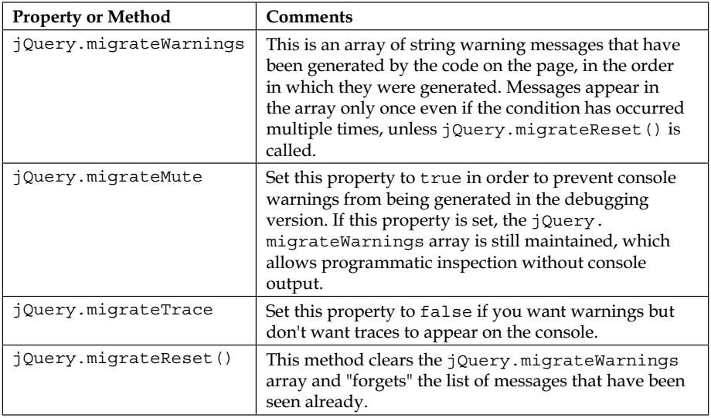
Table 1-0

Slide 10
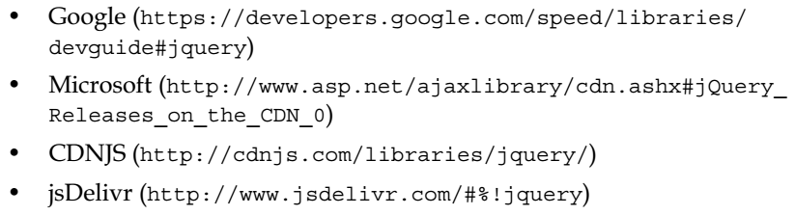
Using a CDN
We can equally use a CDN link to provide our jQuery library—the principal link is provided by MaxCDN for the jQuery team, with the current version available at http://code.jquery.com.
We can, of course, use CDN links from some alternative sources, if preferred—a reminder of these is as follows:
Don't forget though that if you need, we can always save a copy of the file provided on CDN locally and reference this instead.
The jQuery CDN will always have the latest version, although it may take a couple of days for updates to appear via the other links.

Slide 11
Using other sources to install jQuery
Right. Okay, let's move on and develop some code! "What's next?“
I hear you ask. Aha!
If you thought downloading and installing jQuery from the main site was the only way to do this, then you are wrong!
After all, this book is about mastering jQuery, so you didn't think I will only talk about something that I am sure you are already familiar with, right?
Yes, there are more options available to us to install jQuery than simply using the CDN or main download page.
Let's begin by taking a look at using Node.

Slide 12

Using NodeJS to install jQuery
So far, we've seen how to download and reference jQuery, which is to use the download from the main jQuery site or via a CDN.
The downside of this method is the manual work required to keep our versions of jQuery up to date!
Instead, we can use a package manager to help manage our assets.
Node.js is one such system.
Let's take a look at the steps that need to be performed in order to get jQuery installed:
We first need to install Node.js—head over to http://www.nodejs.org in order to download the package for your chosen platform; accept all the defaults when working through the wizard (for Mac and PC).
Next, fire up a Node command prompt and then change to your project folder.
In the prompt, enter this command:
Node will fetch and install jQuery—it displays a confirmation message when the installation is complete:

Slide 13
Using NodeJS to install jQuery |
You can then reference jQuery by using this link:
Node is now installed and ready for use—although we've installed it in a folder locally, in reality, we will most likely install it within a subfolder of our local web server.
For example, if we're running WampServer, we can install it, then copy it into the /wamp/ www/js folder, and reference it using http://localhost/js/jquery.min.js.
Using Node to install jQuery makes our work simpler, but at a cost.
Node.js (and its package manager, NPM) is primarily aimed at installing and managing JavaScript components and expects packages to follow the CommonJS standard.
The downside of this is that there is no scope to manage any of the other assets that are often used within websites, such as fonts, images, CSS files, or even HTML pages.
"Why will this be an issue?," I hear you ask.
Simple, why make life hard for ourselves when we can manage all of these assets automatically and still use Node?

Slide 14
NOTE
If you want to take a look at the source of the jQuery Node Package Manager (NPM) package, then check out https://www.npmjs.org/ package/jquery.

Slide 15
Installing jQuery using Bower
A relatively new addition to the library is the support for installation using Bower—based on Node, it's a package manager that takes care of the fetching and installing of packages from over the Internet.
It is designed to be far more flexible about managing the handling of multiple types of assets (such as images, fonts, and CSS files) and does not interfere with how these components are used within a page (unlike Node).
For the purpose of this demo, I will assume that you have already installed it from the previous section; if not, you will need to revisit it before continuing with the following steps:
Bring up the Node command prompt, change to the drive where you want to install jQuery, and enter this command:
This will download and install the script, displaying the confirmation of the version installed when it has completed, as shown in the following screenshot:

Slide 16
Using the AMD approach to load jQuery
In most instances, when using jQuery, developers are likely to simply include a reference to the main library in their code.
There is nothing wrong with it per se, but it loads a lot of extra code that is surplus to our requirements.
A more efficient method, although one that takes a little effort in getting used to, is to use the AMD approach.
In a nutshell, the jQuery team has made the library more modular;
this allows you to use a loader such as require.js to load individual modules when needed.
It's not suitable for every approach, particularly if you are a heavy user of different parts of the library.
However, for those instances where you only need a limited number of modules, then this is a perfect route to take.
Let's work through a simple example to see what it looks like in practice.

Slide 17
NOTE
Before we start, we need one additional item—the code uses the Fira Sans regular custom font, which is available from Font Squirrel at http:// www.fontsquirrel.com/fonts/fira-sans.

Slide 18
Customizing the downloads of jQuery from Git
If we feel so inclined, we can really push the boat out and build a custom version of jQuery using the JavaScript task runner, Grunt.
The process is relatively straightforward but involves a few steps; it will certainly help if you have some prior familiarity with Git!

Slide 19
Adding source map support
Imagine a scenario, if you will, where you've created a killer site, which is running well, until you start getting complaints about problems with some of the jQuery-based functionality that is used on the site.
Sounds familiar? Using an uncompressed version of jQuery on a production site is not an option; instead we can use source maps.
Simply put, these map a compressed version of jQuery against the relevant line in the original source.
Historically, source maps have given developers a lot of heartache when implementing, to the extent that the jQuery Team had to revert to disabling the automatic use of maps!
Source maps are not difficult to implement; let's run through how you can implement them:
From the code download link that accompanies this book, extract a copy of the sourcemap folder and save it to your project area locally.
Press Ctrl + Shift + I to bring up the Developer Tools in Chrome.

Slide 20
NOTE
For best effects, it is recommended that you use a local web server, such as WAMP (PC) or MAMP (Mac), to view this demo and that you use Chrome as your browser.

Slide 21
Working with Modernizr as a fallback
A best practice when working with jQuery is to ensure that a fallback is provided for the library, should the primary version not be available. (Yes, it's irritating when it happens, but it can happen!)
Typically, we might use a little JavaScript, such as the following example, in the best practice suggestions. This would work perfectly well but doesn't provide a graceful fallback. Instead, we can use Modernizr to perform the check for us and provide a graceful degradation if all fails.
(Page 17).

Slide 22
NOTE
Modernizr is a feature detection library for HTML5/CSS3, which can be used to provide a standardized fallback mechanism in the event of a functionality not being available.
You can learn more at http://www. modernizr.com.

Slide 23
Best practices for loading jQuery

Slide 24
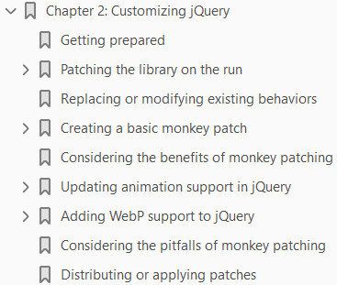
2
Customizing jQuery

Slide 25
Intro
Okay, so we've downloaded a version of jQuery…what do we do next, I wonder?
This is a really good question—let me reveal all!
jQuery has, over the years, become an accomplished library and is used in millions of websites around the world.
While we can usually find a way to fulfill a need using the library, there may be instances where we have to provide our own patch or alteration, to satisfy our needs.
We can use a plugin, but that gets tedious after a while—it soon becomes a case of "plugin this, plugin that" syndrome, where we become too reliant on plugins.
Instead, we can look to the override functionality within jQuery itself; yes, it has some risks, but as we'll see, it is well worth the effort.
Throughout this chapter, we'll cover the basics of overriding jQuery, some of the benefits and pitfalls of doing so, and work our way through some examples of replacing the functionality.

Slide 26
Agenda
We will cover the following topics:
Introducing duck punching
Replacing or modifying existing behaviors
Creating a basic monkey patch
Considering the benefits and pitfalls of monkey patching
Distributing or applying patches
Ready to begin your adventure…? Let's get started!

Slide 27
Getting prepared
At this point, I will recommend that you create a project folder somewhere on your PC—for the purposes of this demo, I will assume that it is called project and is at the root of your main hard disk or C: drive.
Within the folder, go ahead and create several subfolders; these need to be called
fonts
css
js
img

Slide 28
Patching the library on the run
Over the years, hundreds of developers have spent countless hours creating patches for jQuery, to either fix a bug of some description or provide new functionality within the library.
The usual route is to submit a pull request against the Core jQuery library for peer consideration.
As long as the patch works as expected and does not cause issues elsewhere in the library, then it will be submitted to core.
The downside of this approach means that we're constrained by the release schedule for jQuery; while the developers do an outstanding job, it nevertheless can take time before a patch is committed to core.

Slide 29
Introducing monkey patching
What to do? Do we wait in the hope that our patch will be committed?
For some, this won't be an issue—for others, patience may not be their strongest virtue and waiting is the last thing they will want to do!
Fortunately, we can get around this by using a method called monkey patching.
Now—before you ask—let me tell you that I'm not advocating any form of animal cruelty! Monkey patching, or duck punching as it is otherwise known, is a valid technique to create a patch that temporarily overrides the existing functionality within the jQuery Core library during runtime.
Monkey patching comes with its risks: the primary one being that of clashing, should an update introduce a method or function of the same name within the library.
That said, if monkey patching is used with care and forethought, it can be used to update functionality until a more permanent fix can be applied.
It's time, I think, for a demo—we'll be taking a look at how we can improve animation support in jQuery, but first let's take a look at the basics of replacing or modifying the jQuery core at runtime.

Slide 30
NOTE
Later in this chapter, we'll take a look at some of the risks that need to be considered.

Slide 31
Replacing or modifying existing behaviors
So, how can we effect a (temporary) change in the core functionality of jQuery?
It all starts with the use of an Immediately Invoked Function Expression (IIFE); we then simply save a version of the original function before overriding it with our new function.
Let's see what the basic framework looks like in action: Code 2-1.
If you were expecting something more complex, then I am sorry to disappoint you; there isn't a great deal of complexity required for a basic monkey patch!
The extent of what goes into a patch will really come down to what it is that you are trying to fix or alter within the existing code.
To prove that this really is all that is required, let's take a look at an (albeit over-simplified) example.
In the example, we'll use a standard click handler to show the response that a dog will give to its owner…except that our dog seems to have developed a personality problem.

Slide 32
NOTE
You may have heard the term self-executing anonymous function being used; it is a misleading phrase, although it means the same thing as an IIFE, which is a more accurate description.

Slide 33
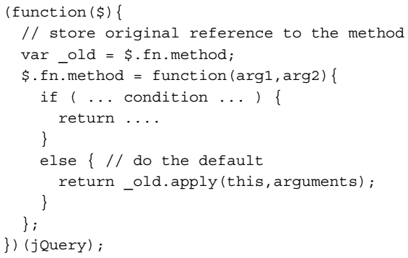
Code 2-1

Slide 37
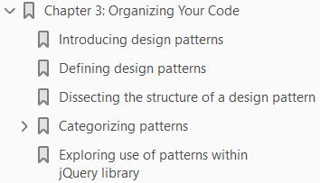
3

Slide 38
Intro

Slide 39
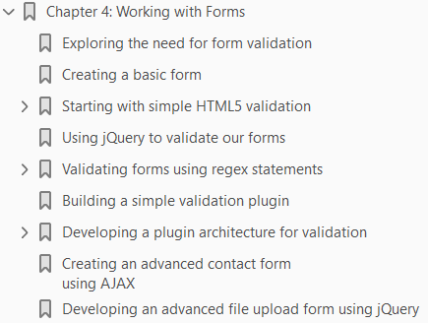
4

Slide 40
Intro

Slide 41
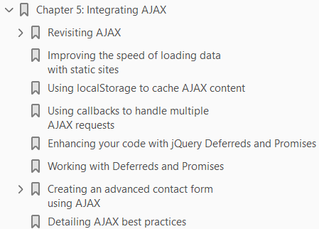
5

Slide 42
Intro

Slide 43
6

Slide 44
Intro

Slide 45
7

Slide 46
Intro

Slide 47
8

Slide 48
Intro

Slide 49
9

Slide 50
Intro

Slide 51
10

Slide 52
Intro

